Slide 1

Building an Algorithmic Trader
Presented by “The Survivors” – Peter, Mandy, Steven, Ragini, Nathan

Slide 2
Project Approach
The group, which is composed of Ragini, Peter, Steven, Nathan, and Mandy, were tasked with working together to analyze a fintech problem or develop an application that solves a real world tech problem. The scope of the project is developing a tool to compare trading strategies to inform personal investment portfolios. Working remotely, the group agreed upon assigned duties and worked individually and together to create the application.
To fully realize the application, the group studied several trading strategies and chose four of them to chart out. These strategies include Donchian’s Four Week Rule, Dreyfus’s 52 Week Rule, Turtle Trading, Golden Cross 20 v200 SMA. In addition, the group studied several sectors traded on the stock exchanges in order to compare and contrast. They then used this information to provide charts to inform trading strategies. The group found data sets using Yahoo Finance and Alpaca Markets.
The technology used to create the application include Jupyterlab, Pandas, Plotly and Hvplot and most of the data is pulled from yfinance. The code written was tested against the data to determine the most successful strategies historically. Ultimately the group’s goal of creating a fully working application was not realized, however, there now exists a solid framework for creating such an application. Moving forward, the group will continue working on the application for personal use, and looks forward to sharing with other members of the class.

Slide 3
Goals and Objectives
Learn about successful Trend Trading Methodologies
Research and download varying APIs
Research Sector Exchange Traded Funds (ETFs)
Writing Python code using Jupyterlab, Pandas, yfinance, Plotly
Test code against data to determine which methodologies are most successful historically
Create the basic structure for an Algorithmic Trader

Slide 4
What markets are we testing our strategies against?
Ragini to add info on sector research.
Test how these strategies operate in different markets
List all the sectors and list the ticker symbols
List all the markets we are testing our strategy against
Test against SPY and NASDAQ and any specific companies
Ensure we have list all of the sectors that we wanna test and than provide symbols.

Slide 5
Data Collection & Cleaning

Slide 6
Data Exploration
We are gonna paste our graphs in this slide which we will create by using Python code

Slide 7
Featured Trading Strategies source – The Universal Tactics of Successful Trend Trading by Brent Penfold

Slide 8
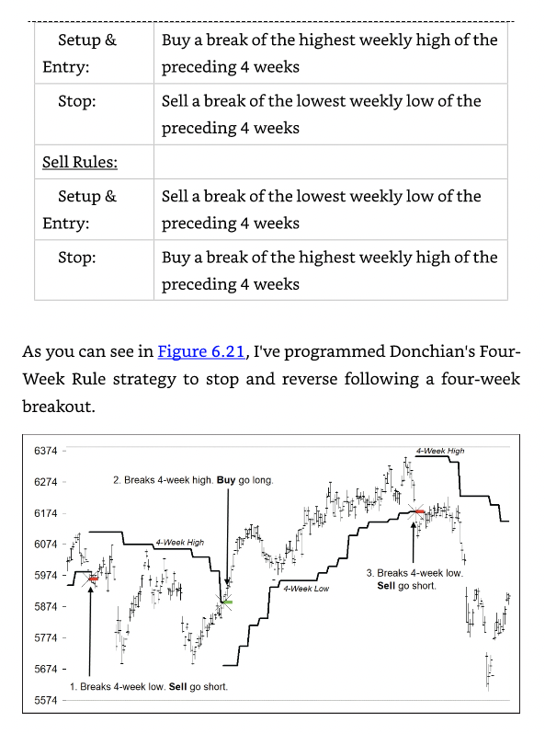
Donchian’s 4 Week Rule
Follows a four-week break-out. If model is short and market takes out highest weekly high, exit and reverse going long. If the model is long and the market takes out the lowest weekly low, exit and reverse going short.

Slide 9
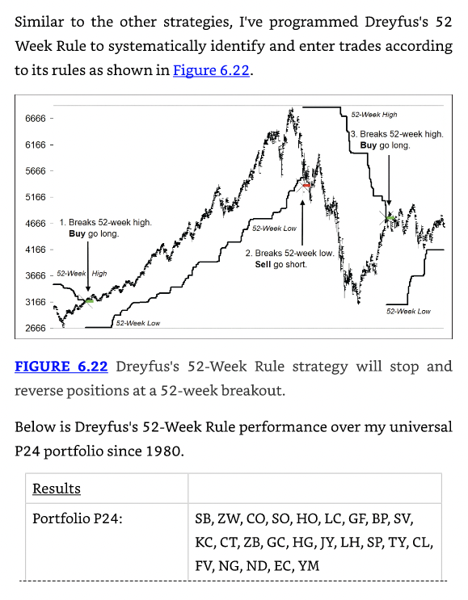
Dreyfus’s 52 Week Rule
Similar to Donchian’s four week rule but the adjustment is made at 52 weeks rather than 4.

Slide 10
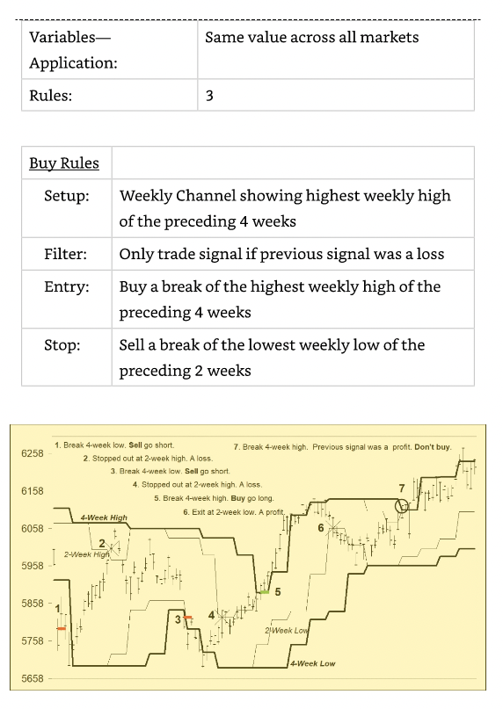
Turtle Trading
Improves upon Donchian’s 4 week by introducing a two-week breakout stop and overlaying a filter requiring a previous losing signal to be in place before taking a trade.

Slide 11
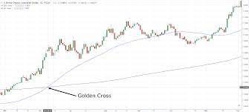
Golden Cross
Can be any number of days usually compared with a 200 day moving average, a Golden Cross exists when the determined number of days crosses with the 200 day and signals a buy.

Slide 13
Successful Trading Strategies

Slide 14
APIs
Alpaca – Add something about Alpaca?
BackTrader
We chose to use Backtrader because its tools are more accessible to someone building their own application. Adding more here if needed.

Slide 15
Coding stuff and Data Collection
Add nifty chart here?
Add clever stuff here?

Slide 16
Data and Code
More cool stuff we built
A neat chart

Slide 17
Sample of the final Application
Doo da doo

Slide 18
Group Approach
Evaluate talent of each group member and assign responsibilities accordingly. Separate into coding, researching, building presentation etc. Add more here.
Insert interesting or funny picture.

Slide 19
Conclusions
Group Discussion – What are our conclusions?
What did we learn individually and as a group?
What would we do differently?
What did we do well?

Slide 20
Next Steps
How will we use the knowledge and applications we have built in the future?

